Slide 1
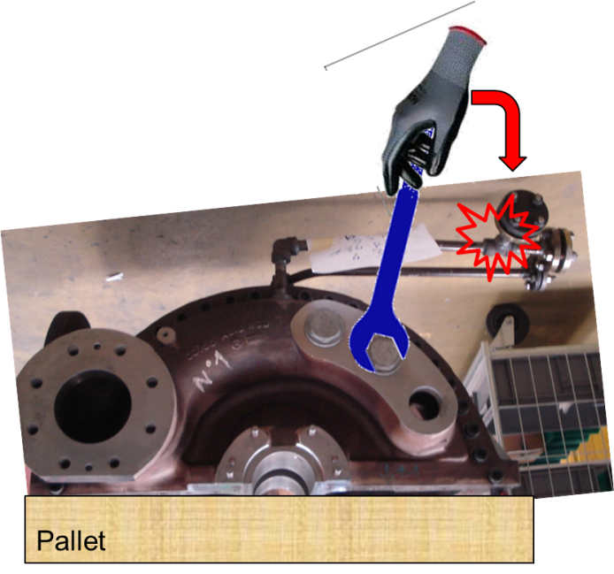
HS&E INCIDENT BULLETIN |  | 2nd half year 2014
France | Type of incident - Wrong tool for the task
Summary:
The operator was tightening a bolt of a turbine casing using a size 70 wrench on a size 67 bolt. The wrench slipped and his finger hit a flange nearby. The finger was pinched between the flange and the wrench, which caused a wound at the third phalanx (bone) and pressure buildup under the nail. He received 5 stitches and missed 41 days of work due to the injury. The operator was wearing gloves at the time of the incident
Root Causes: | Actions Taken Thus Far: Next Steps
Wrong tool for the task | Replace this type of wrench with a safer ratchet-style wrench, change the bolt size in the standard model, ensure the correct size of wrench is available in toolboxes.

